Slide 1
Branch-and-Bound
From: Design & Analysis of Algorithm
By Anany Levitin

Slide 2
Branch-and-Bound
Compared to backtracking, branch-and-bound requires two additional items:
A way to provide, for every node of a state-space tree, a bound on the best value of the objective function on any solution that can be obtained by adding further components to the partially constructed solution represented by the node
The value of the best solution seen so far

Slide 3
Branch-and-Bound
If this information is available, we can compare a node’s bound value with the value of the best solution seen so far.
If the bound value is not better than the value of the best solution seen so far. The node is nonpromising and can be terminated (some people say the branch is “pruned”). Because no solution obtained from it can yield a better solution than the one already available.
This is the principal idea of the branch-and-bound technique.

Slide 4
Branch-and-Bound
In general, we terminate a search path at the current node in a state-space tree of a branch-and-bound algorithm for any one of the following three reasons:
The value of the node’s bound is not better than the value of the best solution seen so far.
The node represents no feasible solutions because the constraints of the problem are already violated.
The subset of feasible solutions represented by the node consists of a single point (and hence no further choices can be made)—in this case, we compare the value of the objective function for this feasible solution with that of the best solution seen so far and update the latter with the former if the new solution is better.

Slide 5
Assignment Problem
There are n people who need to be assigned to execute n jobs, one person per job.
The cost that would accrue if the i^{th} person is assigned to the j^{th} job is a known quantity C[i, j ] for each pair i, j = 1, 2, . . . , n. The problem is to find an assignment with the minimum total cost.
An instance of the assignment problem is specified by an n × n cost matrix C so that we can state the problem as follows:
Select one element in each row of the matrix so that no two selected elements are in the same column and their sum is the smallest possible

Slide 6
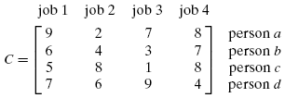
Assignment Problem
We will demonstrate how assignment problem can be solved using the branch-and-bound technique by considering the above small instance of the problem.
It is clear that the cost of any solution, including an optimal one, cannot be smaller than the sum of the smallest elements in each of the matrix’s rows.

Slide 7
Assignment Problem
Here we will generate all the children of the most promising node among nonterminated leaves in the current tree. (Nonterminated, i.e., still promising, leaves are also called live.)
How can we tell which of the nodes is most promising?
We can do this by comparing the lower bounds of the live nodes. It is sensible to consider a node with the best bound as most promising.
This variation of the strategy is called the best-first branch-and-bound.
The lower-bound value for the root, denoted lb, is 10

Slide 8
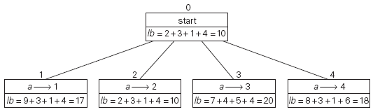
Assignment Problem
The number above a node shows the order in which the node was generated.
A node’s fields indicate the job number assigned to person a and the lower bound value, lb, for this node.

Slide 9
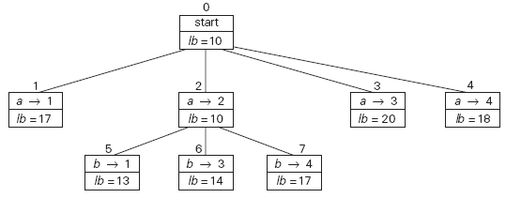
Assignment Problem
Levels 0, 1, and 2 of the state-space tree for the instance of the assignment problem being solved with the best-first branch-and-bound algorithm.

Slide 10
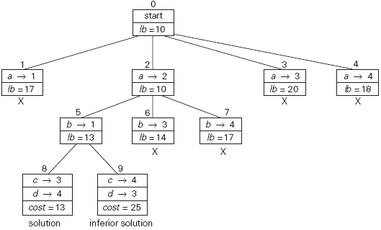
Assignment Problem
Complete state-space tree for the instance of the assignment problem solved with the best-first branch-and-bound algorithm.

Slide 11
Traveling Salesman Problem
In layman’s terms, the problem asks to find the shortest tour through a given set of n cities that visits each city exactly once before returning to the city where it started.
The problem can be conveniently modeled by a weighted graph, with the graph’s vertices representing the cities and the edge weights specifying the distances.
This the problem can be stated as the problem of finding the shortest Hamiltonian circuit of the graph. (A Hamiltonian circuit is defined as a cycle that passes through all the vertices of the graph exactly once).

Slide 12
Traveling Salesman Problem
Here we compute a lower bound on the length l of any tour as follows.
For each city i, 1≤ i ≤ n, find the sum si of the distances from city i to the two nearest cities; compute the sum s of these n numbers, divide the result by 2, and, if all the distances are integers, round up the result to the nearest integer:

Slide 13
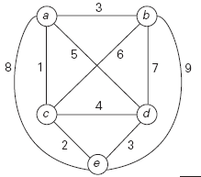
Traveling Salesman Problem
For example, for the instance in the following Figure formula yields.

Slide 14
Traveling Salesman Problem
for any subset of tours that must include particular edges of a given graph, we can modify lower bound accordingly.
For example, for all the Hamiltonian circuits of the graph in Figure that must include edge (a, d), we get the following lower bound by summing up the lengths of the two shortest edges incident with each of the vertices, with the required inclusion of edges (a, d) and (d, a):

Slide 15
Traveling Salesman Problem
We now apply the branch-and-bound algorithm, with the bounding function discussed in last slide, to find the shortest Hamiltonian circuit for the graph in the example shown.
To reduce the amount of potential work we will consider two following things.
we can consider only tours that start at a.
because our graph is undirected, we can generate only tours in which b is visited before c. In addition, after visiting n − 1= 4 cities, a tour has no choice but to visit the remaining unvisited city and return to the starting one.

Slide 16
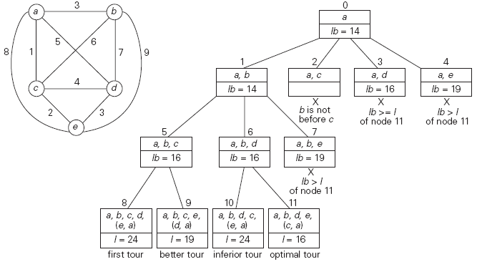
Traveling Salesman Problem

